Slide 1

Security Analytics
Analysis Toolkit for Stocks, Bonds, Cryptocurrencies, and ETFs
Notes:
Security Analytics is a browser based toolkit that will allow the user to analyze their favorite financial securities and portfolio.
O

Slide 2
What will it do?
Browser based Analytical toolkit
Display real time security index
Provide Extremely Detailed Historical Data for past 20 years
Display various graphs using D3 to help user with analysis
Provide various Economic Info such as Fed Interest Rate or US trade deficit

Slide 3
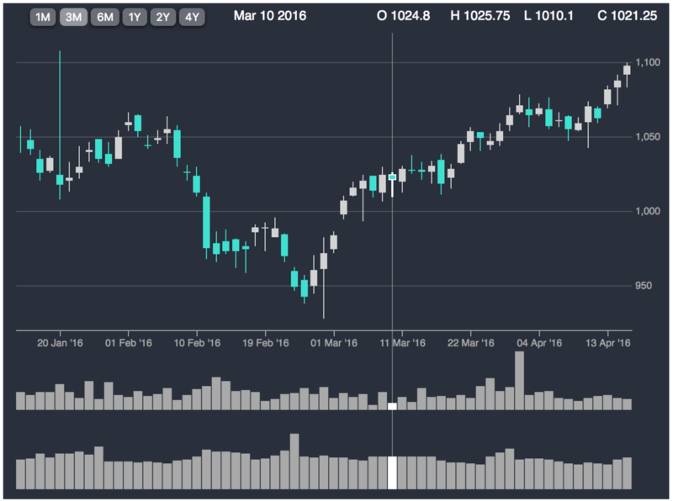
Graphs Available
Candle Graph

Slide 4
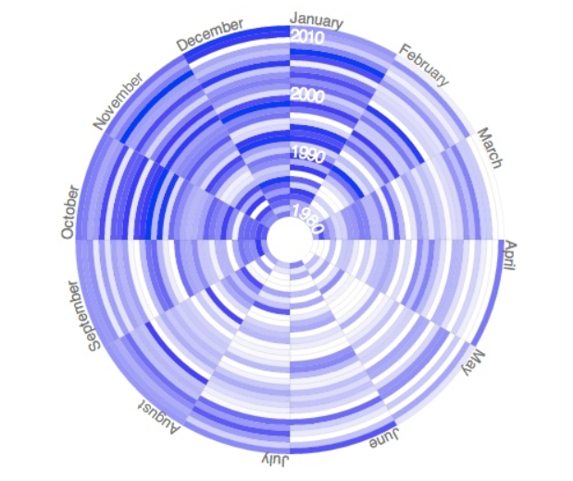
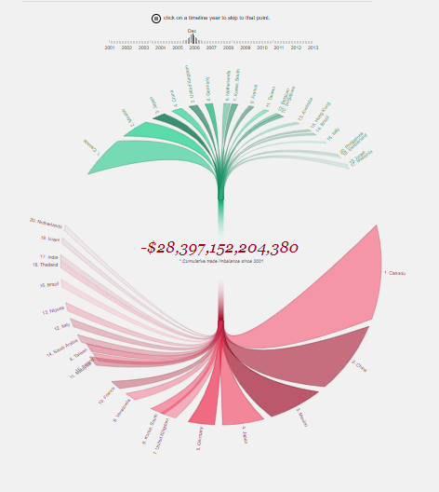
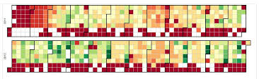
Possible Additional Features
Circular Heat Map
US Trade Deficit
D3 Calendar

Slide 5
What’s Under the Hood
D3.js
Moment.js
HTML
CSS
Express
Node.js
MySQL
Alpha Vantage API

Slide 6
Targeted Audience
Small Independent
Investors
Financial Advisors
Day Traders
Brokerage Firms
Economic Scientist
Students
Anyone who wants to make a smart investment

Slide 7
Questions

